Slide 1
Using HRTFs for virtual sound source positioning
Lecture Example 2018
(updated 2020)
Franz Zotter

Slide 2
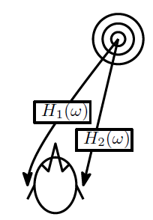
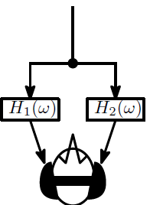
HRTFs / HRIRs
Filters/transfer functions to ear signals for source direction, free field

Slide 3
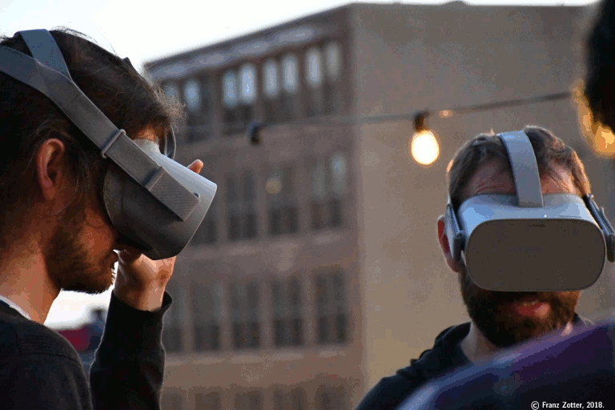
Why?
BBC „binaural sound“ example: KU100 dummy head
Recording like radio drama (performance)
BBC turning forest
objects with trajectories etc., artificial components
can be interactive (head rotation, controllers, etc)
Other reasons:
Room and loudspeakers for
electroacoustic performance or
listening test might be
unavailable/difficult to bring
together

Slide 4


How
Lateral:
TOA
(ITD)
ILD:
at frequencies higher than 1kHz,
attenuation on distant ear

Slide 5
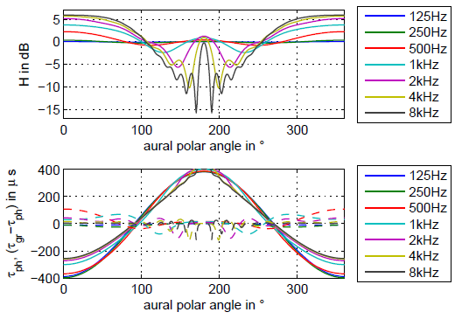
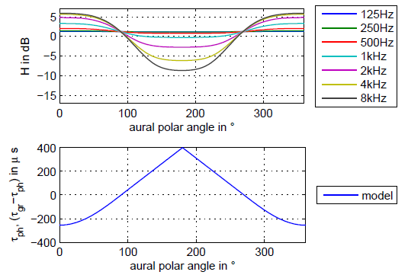
How
Learning and supplementary material, source code
http://iaem.at/Members/zotter/using-hrtfs

Slide 6
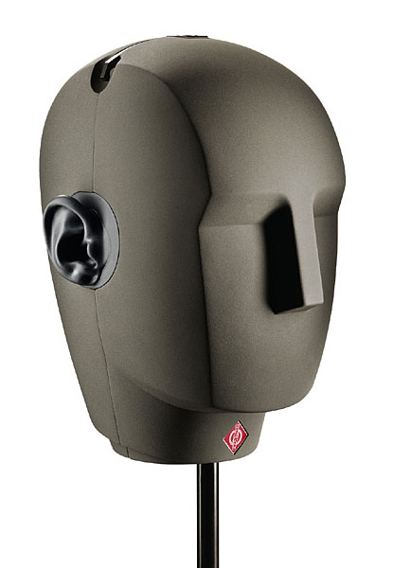
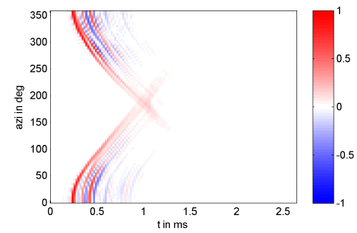
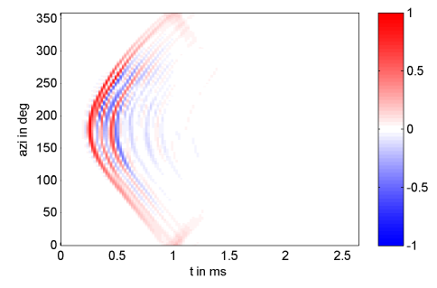
How
Learning and supplementary material, source code
http://iaem.at/Members/zotter/using-hrtfs
KU100 dummy head measurements
(Benny Bernschütz, TH Cologne 2013)

Slide 7
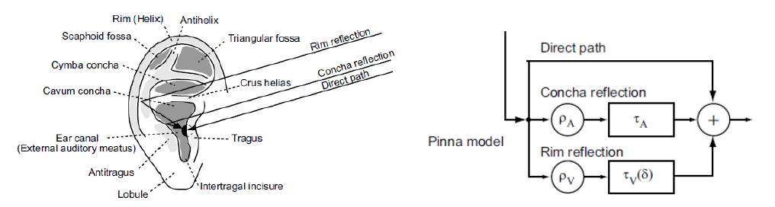
How
At frequencies even higher (above 3kHz)
Spectral detail (Satarzadeh+Algazi+Duda 2007)
Maybe easier to measure? SOFA-Database https://www.sofaconventions.org/mediawiki/index.php/SOFA_(Spatially_Oriented_Format_for_Acoustics)
SADIE II https://www.york.ac.uk/sadie-project/database.html

Slide 8
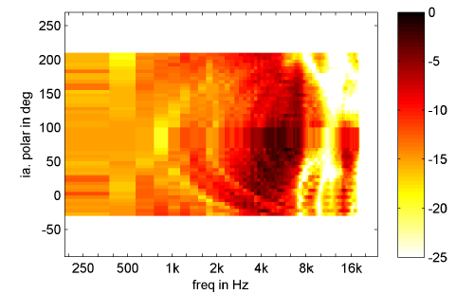
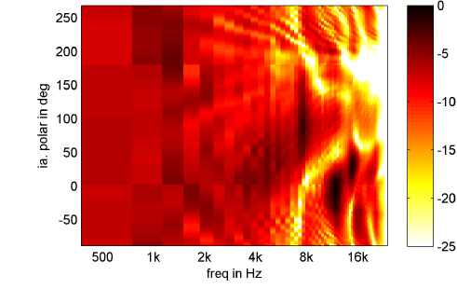
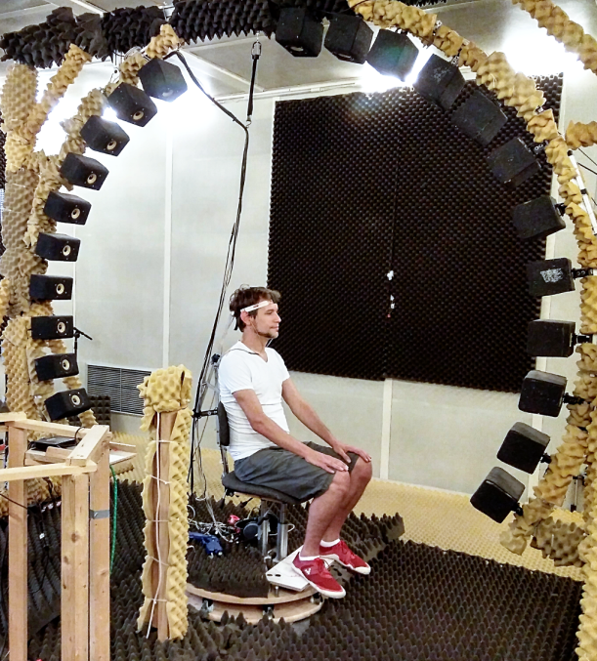
How (e.g. ARI Vienna, Piotr Majdak)
ARI Vienna
8kHz: cp. Blauert (spatial hearing)
Resonances+notches (front)

Slide 9
Implementation examples
Pd-example w/o reverberation:
KU100 HRIRs
Franz‘s individual ARI HRIRs http://iaem.at/Members/zotter/using-hrtfs
Free VST Plugins:
psypan
BinAural (Tomasz Wozniak, open source – try to read)
Sennheiser AMBEO Orbit
IEM Binaural Decoder (Zaunschirm+Schörkhuber 2018)
Ircam Spatialisateur - spat (allows indiv. HRIRs)
TuneIn 3D – interpolation
Commercial tool examples with individualization
https://new.steinberg.net/immerse/
https://www.genelec.com/aural-id

Slide 10
Why does it not always externalize well?
Median plane is diffucult!
Is there a room response?
Sinker, Jasmina Catic, …
Divergence between simulated and headphone-listening room?
Stephan Werner/Florian Klein,
Head tracking?
Durant Begault, Florian Völk, …
Headphone EW
Benny Bernschütz, Fabian Brinkmann, indiv: Marko Hipaaka - hefio
Individual HRIRs/BRIRs?
Durant Begault, Florian Völk, Gert Henrik Hassager, …
Recommeded: excellent recent Literature (2019, 2020):
Virginia Best/Robert Baumgartner, Josefa Oberem/Janina Fels /
Florian Denk (PhD) / Fabian Brinkmann (PhD) / Florian Wendt (PhD)

Slide 11
Learning material
http://iaem.at/Members/zotter/using-hrtfs
learning and supplementary material (source code, data, plugin comparison)

